Slide 2
Course- ENVIRONMENTAL STUDIES
Course Code – 22447
CO-a: Develop Public Awareness about Environment.
Unit Outcome- UO 1a,1b, and 1c
Topic – 1
Environment
MSBTE LEAD- STUDY AT YOUR DOORSTEP

Slide 3
What we will learn today
Understand about environment and its segments.
1. | Agenda point – Environment , its need and Scope.
2. | Agenda point – Segments of Environment
  Content
  1.1 Definitions. need of environmental studies.
  1.2 Segments of environment-Atmosphere, Hydrosphere Lithosphere, Biosphere.

Slide 4
Learning Objective/ Key learning
1a. Discuss the scope of environment.
1b. Describe various types of environment
1c. Describe the importance of environmental studies.

Slide 5


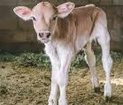

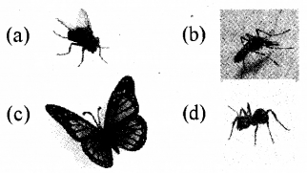
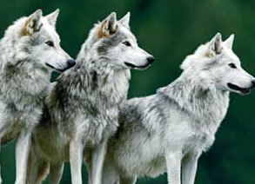
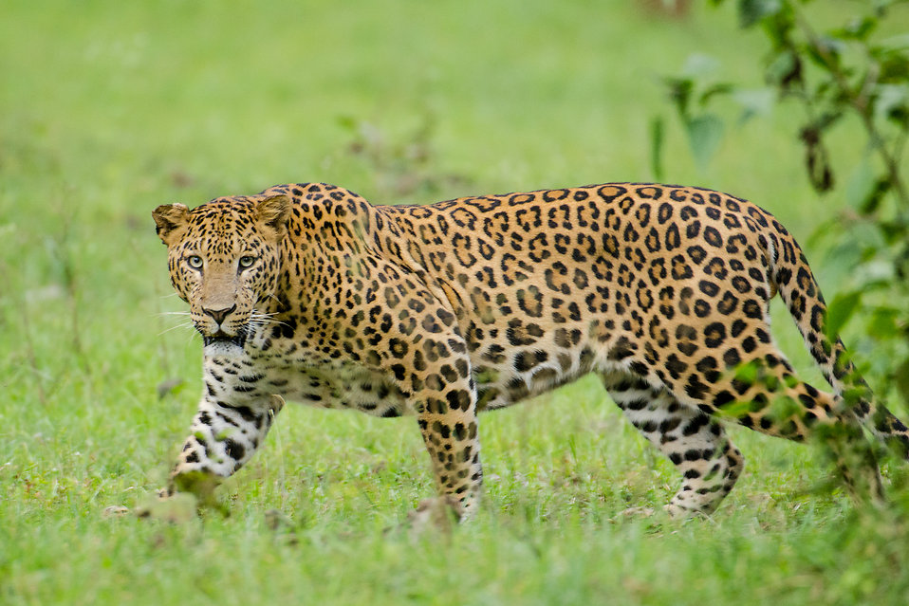
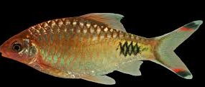
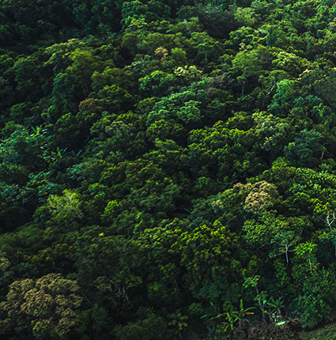
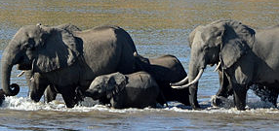

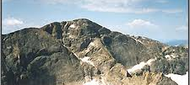
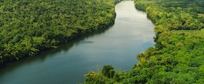
Concept Map of Environment

Slide 6
UNIT 1: ENVIRONMENT
Environment
The word environment is derived from the French verb ‘enviro’ which means ‘surrounding’. Thus, our environment can be defined as the physical, chemical and biological world that surround us.
In Simple way the Environment is A place around us includes people, children, benches, ground, grass, trees, insects, birds, sunlight, air, land, water, mountain etc.
Biotic components constantly interact and exchange things with each other as well as with abiotic components, for their survival and existence.
Biotic Components
Abiotic Components
Living Things
Non-Living Things
e.g. People, Children, Trees, Grass, Plants, insects, Birds etc.
e.g. Play ground, Benches, Swings, Slide, Air, Water, Mountain etc.

Slide 7
Types of Environment
Natural
Environment
Man-made
Environment
Social
Environment
Psychological
Environment
The environment changed or modified by the interference of human beings is called man made environment.
e.g., Infrastructure, Utilities, Institutions, housing, industries , parks, buildings, energy networks, transportations, etc
Social Environment includes an individual’s social, economic and political condition wherein he lives.
e.g., Customs, Traditions, ethics, Language, Culture, Professions, Living conditions etc
Every individual has his own psychological environment, in which he lives.
The Psychological environment enables us to understand the personality of an individual. Both the person and his goal from psychological environment
The environment in its original form without the interference of human beings is known as natural environment.
All living and nonliving things occurring naturally on earth

Slide 8
STRUCTURE OF ENVIRONMENT :
Physical Environment
Biological Environment
(i) Solid - The lithosphere (solid earth) : Soil / land and Mountain Environment
(ii) Liquid - The hydrosphere (water component) : River, Reservoir, Oceans and Glacier Environment
(iii) Gas - Various gases (oxygen, carbondioxide, nitrogen, méthane etc. present in atmosphere.
i) Plants (flora): trees, grass, shrubs etc.
(ii) Animals (fauna) : domestic and wild animals, humans, birds, insects etc.

Slide 9
SCOPE OF ENVIRONMENTAL STUDIES
This subject educates the students, citizens and experts to understand the complexity of environmental issues.
Experts having knowledge in the environmental fields that enables them to facilitate the solution of environmental problems.
The current trend of environmental degradation can be reversed if people of educated communities are organized and empowered.
By knowing this subject we can develop eco-friendly new technologies for various developments which can save the natural resources as well as reduces environmental pollutions and public health impacts.
As, the new earth is not discovered till now we have no other option except to maintain the ecological balance on the planet Earth so that the liveable environment should be kept for our future generations.
The major areas in which the role of environmental scientists are of vital importance are natural resources, ecosystems, biodiversity and its conservation, environmental pollution, social issues, human population and environment.

Slide 10
NEED AND IMPORTANCE OF ENVIRONMENTAL STUDIES:
Public awareness.
Environment issues being of international importance.
Problems cropped in the wake of development.
Conserve energy.
For an alternative solution.
Save species from extinction.
Save the natural resources.
Reduce the pollution.
Wise planning of development.
Sustainable development

Slide 11
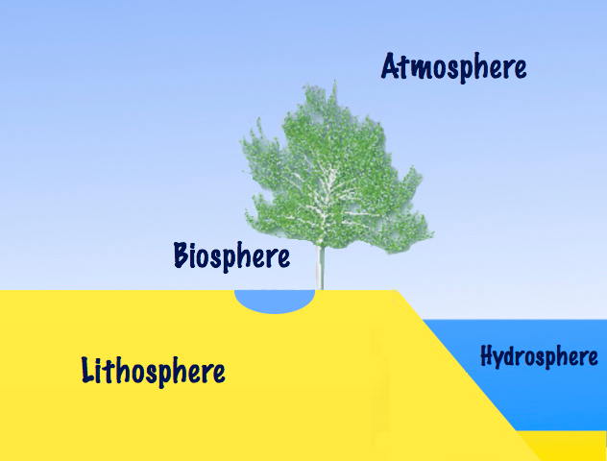
SEGMENTS OF ENVIRONMENT
The atmosphere is composed of nitrogen and oxygen. Besides, argon, carbon dioxide, and other trace gases.
Biosphere: Biosphere indicates the realm of living organisms and their
interactions with environment, viz atmosphere, hydrosphere and lithosphere.
Hydrosphere: The Hydrosphere comprises all types of water resources oceans, seas, lakes, rivers, streams, reservoir, polar icecaps, glaciers, and ground water.
Lithosphere: Lithosphere is the outer mantle of the solid earth. It consists of minerals occurring in the earth’s crusts and the soil e.g. minerals, organic matter, air and water.

Slide 12
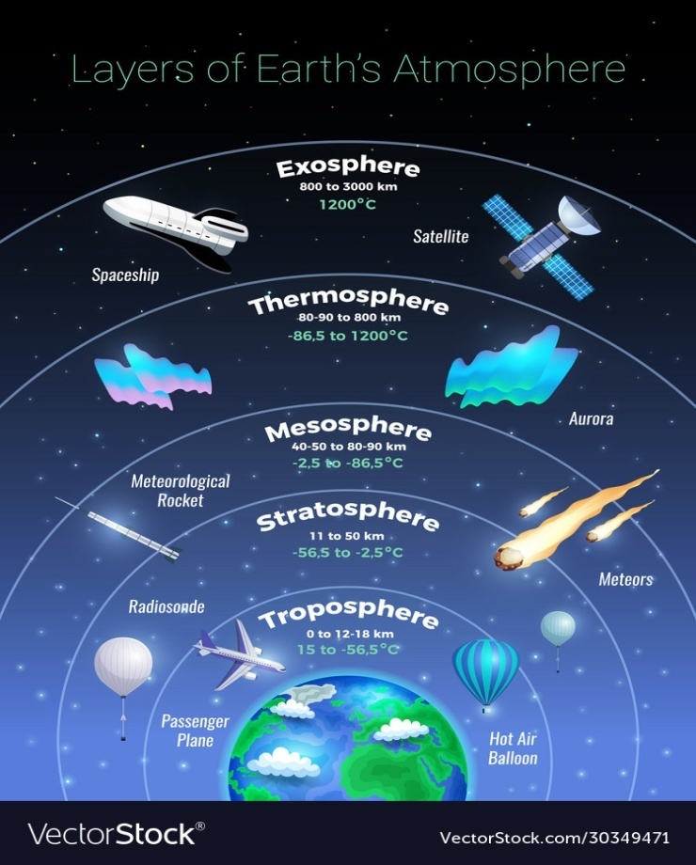
SEGMENTS OF ENVIRONMENT
Atmosphere: The atmosphere implies the protective blanket of gases, surrounding the earth:
(a) It sustains life on the earth.
(b) It saves it from the hostile environment of outer space.
(c) It absorbs most of the cosmic rays from outer space and a major portion of the electromagnetic radiation from the sun.
(d) It transmits only here ultraviolet, visible, near infrared radiation (300 to 2500 nm) and radio waves. (0.14 to 40 m) while filtering out tissue-damaging ultra violate waves below about 300 nm.

Slide 13
SEGMENTS OF ENVIRONMENT
Hydrosphere: The Hydrosphere comprises all types of water resources oceans, seas, lakes, rivers, streams, reservoir, polar icecaps, glaciers, and ground water. 71 % of earth area is covered by water.
(i) Nature 97% of the earth’s water supply is in the oceans,
(ii) About 2% of the water resources is locked in the polar icecaps and glaciers.
(iii) Only about 1% is available as fresh surface water-rivers, lakes streams, and ground water fit to be used for human consumption and other uses.
Lithosphere: Lithosphere is the outer mantle of the solid earth. It consists of minerals occurring in the earth’s crusts and the soil e.g. minerals, organic matter, air and water.
Biosphere: Biosphere indicates the realm of living organisms and their interactions with environment, viz atmosphere, hydrosphere and lithosphere.

Slide 14
Revision
What we have leaned today?
Environment its definition and scope.
Types of environment.
Structure of environment.
Needs and importance of environment.
Segments of environment.

Slide 15
References
Dr Prabhu Prasadini and Dr G. Swarajya Lakshmi, ENVIRONMENTAL SCIENCE, BIRM 301 Study Material.
Dr. Y. K. Singh, 2006. Environmental Science. NEW AGE INTERNATIONAL (P) LIMITED, PUBLISHERS, New Delhi, India.
Rokonuzzaman M. S., 2014. Types of Environment, Department of Geology and Environment, Dhaka, Bangladesh.
Prof. Erach Bharucha, 2004. Textbook for Environmental Studies. University Grants Commission, New Delhi. India.
Michael Aaleby, 2000. Basics of Environmental science, 2nd Edition, Taylor & Francis Group, New York.
www.vectorstock.com, Accessed on 02/07/2020.

Slide 16

THANK YOU ALL
HAVE A NICE DAY
HAPPY LEARNING

